Slide 1
GSR and FishEye State Routing
Atharv Guhagarkar
Anantish Deshpande

Slide 2
OVERVIEW – WIRELESS MOBILE COMMUNICATION
Two Distinct approaches to mobile wireless comm.
Fixed network infrastructure .
Eg: Cellular technologies – GSM, UMTS, WIMAXEthernet – Wireless LANSatellite
No fixed infrastructure Ad-hoc network.
Both types need routing protocol to route messages through network.

Slide 3
2 main types of table driven protocols:
Distance Vector:
Entire routing table is sent to neighbors periodically
Neighbors compare routing table for shorter routes
Link State:
Each node maintains a topology DB, essentially a view of the entire network
When topology changes only state of specific affected link needs to be sent to update topology
Each node creates it’s routing table by running SP algorithm on topology DB to create a SP tree of network with itself as center
Link State is better in terms of performance

Slide 4
WHAT IS AD-HOC NETWORKING?
No centralized infrastructure
Each node is both a router & a host
Wireless nodes discover each other (based on Tx range) & forms network
Mobility causes changing network topology
Nodes join/quit network at any time
No centralized network admin
Nodes can have limited resources: CPU, storage, power, BW – not unlike sensor networking

Slide 5
Routing in wireless ad hoc networks or MANETs
generally categorized into:
Proactive routing
Reactive routing
Hybrid routing
Hierarchical routing

Slide 6
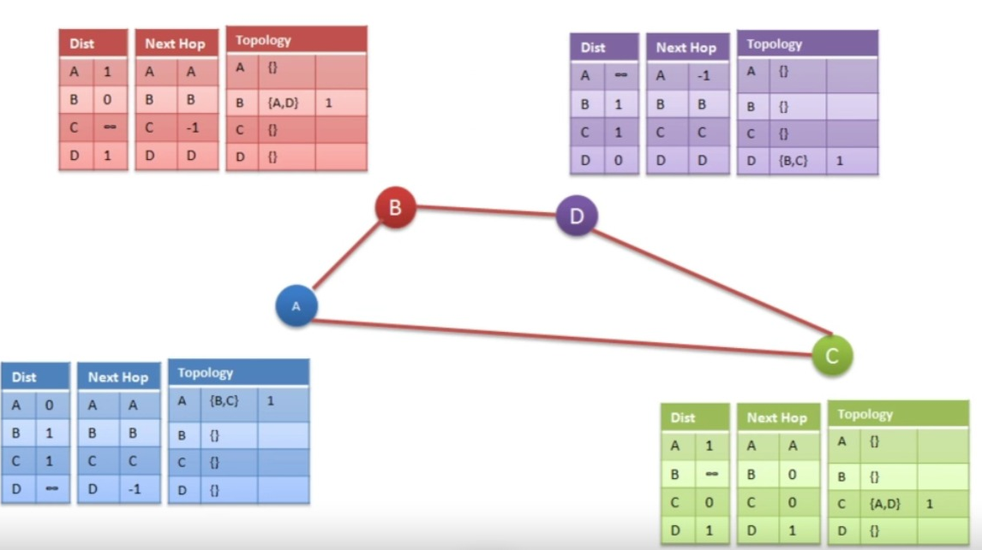
GSR (Global State Routing)
This stores info about LS and time stamp
Rcvd info
Seq No.

Slide 7
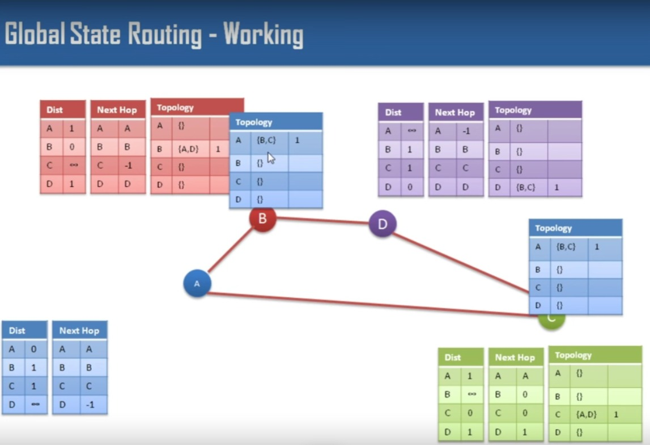
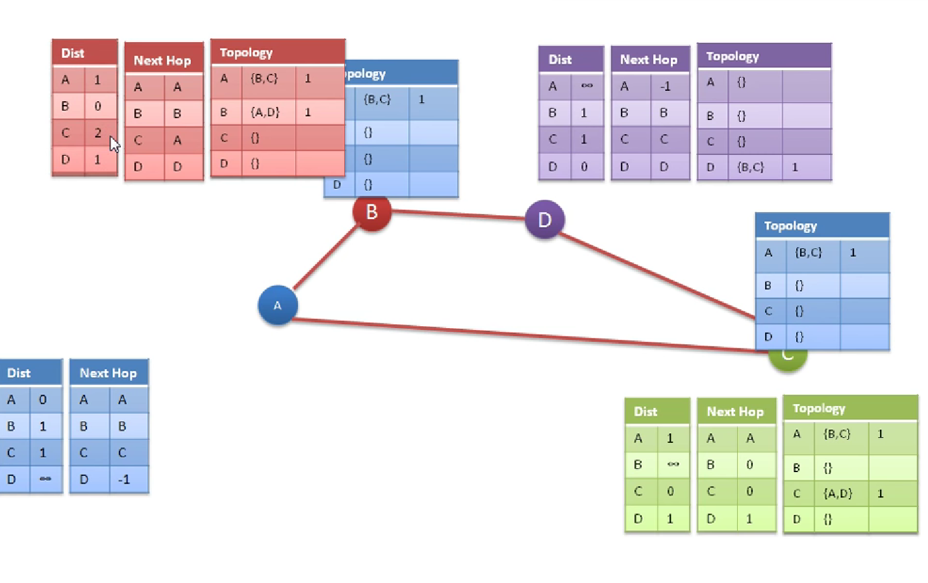

Slide 8
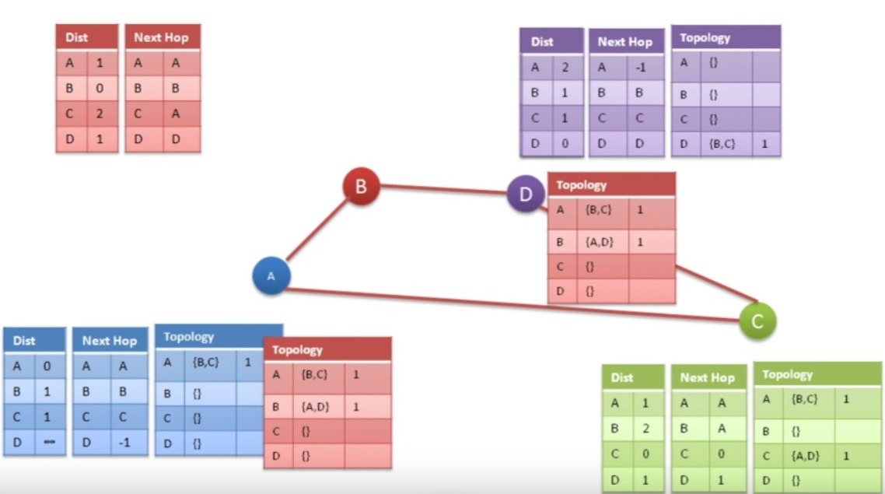
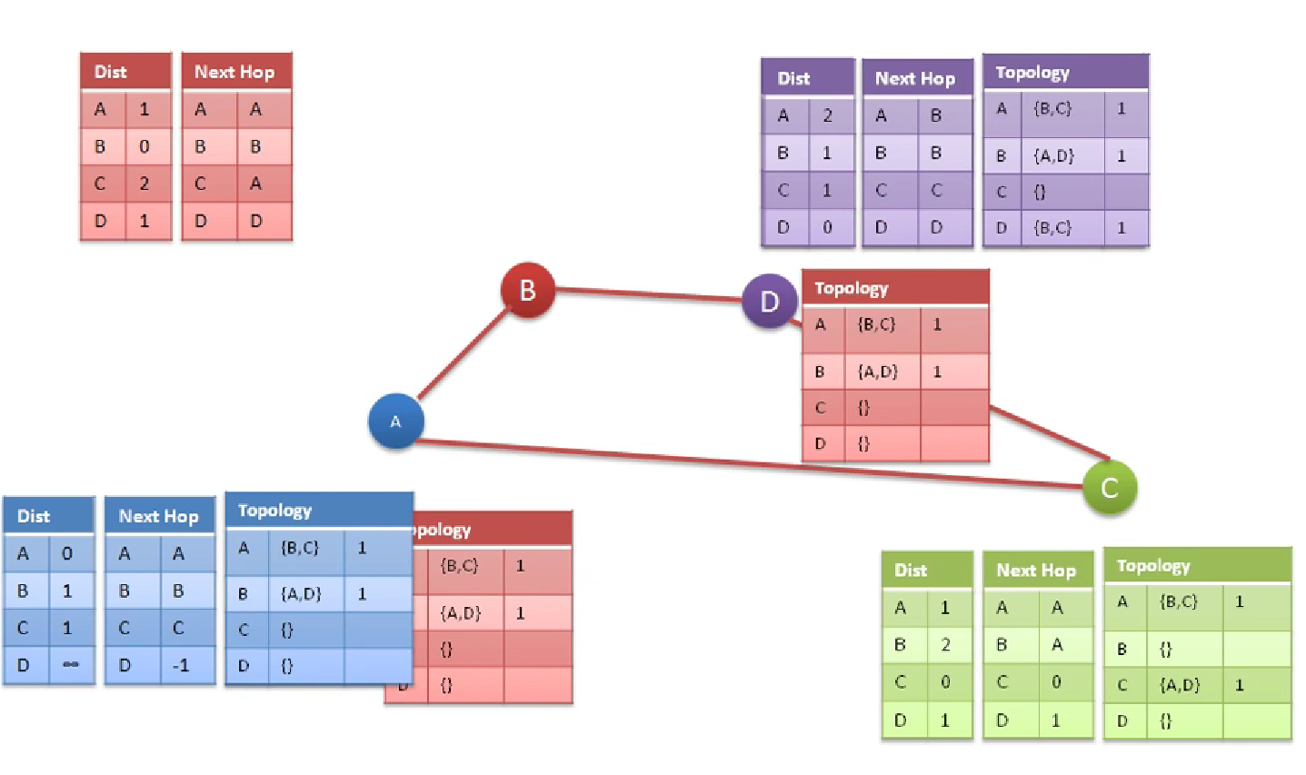


Slide 9
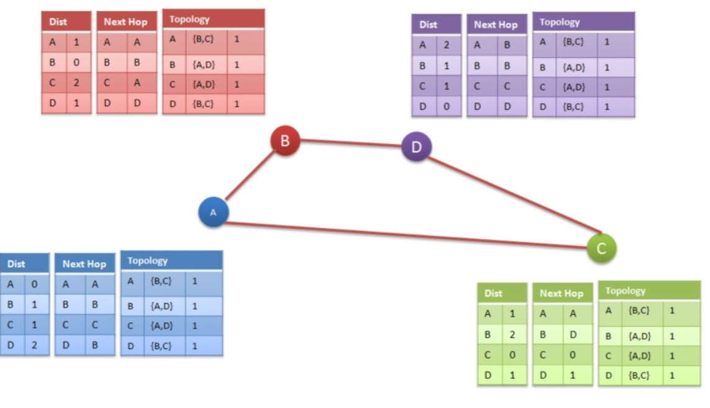

Slide 10
Problems of GSR
Size of Topology Table.
Consumption of Bandwidth.
Higher operational cost.

Slide 11
FISHEYE ROUTING PROTOCOL- A PROTOCOL FOR AD-HOC NETWORKS
Each node maintains accurate info. with neighbors within a configurable distance (x) from itself by exchange frequent updates.
While maintaining “not so accurate” info with the rest of the network by only sending infrequent updates.
Updates are also periodic (configurable) instead of event driven.

Slide 12
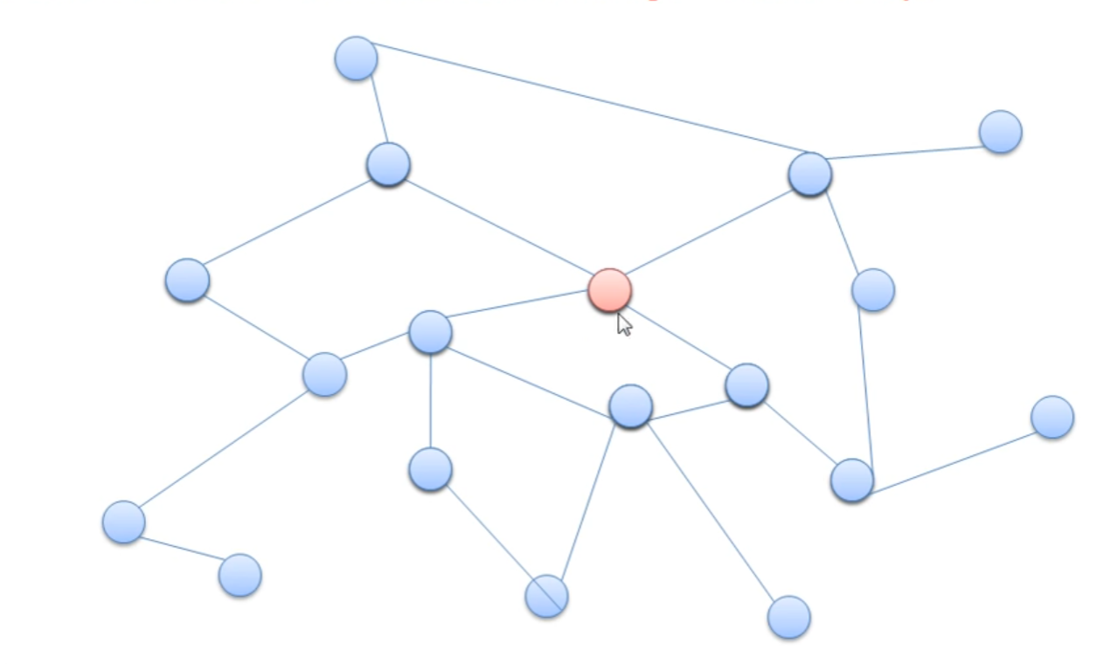
Design
Fisheye Routing divides network into many scopes.
What is the scope?

Slide 13
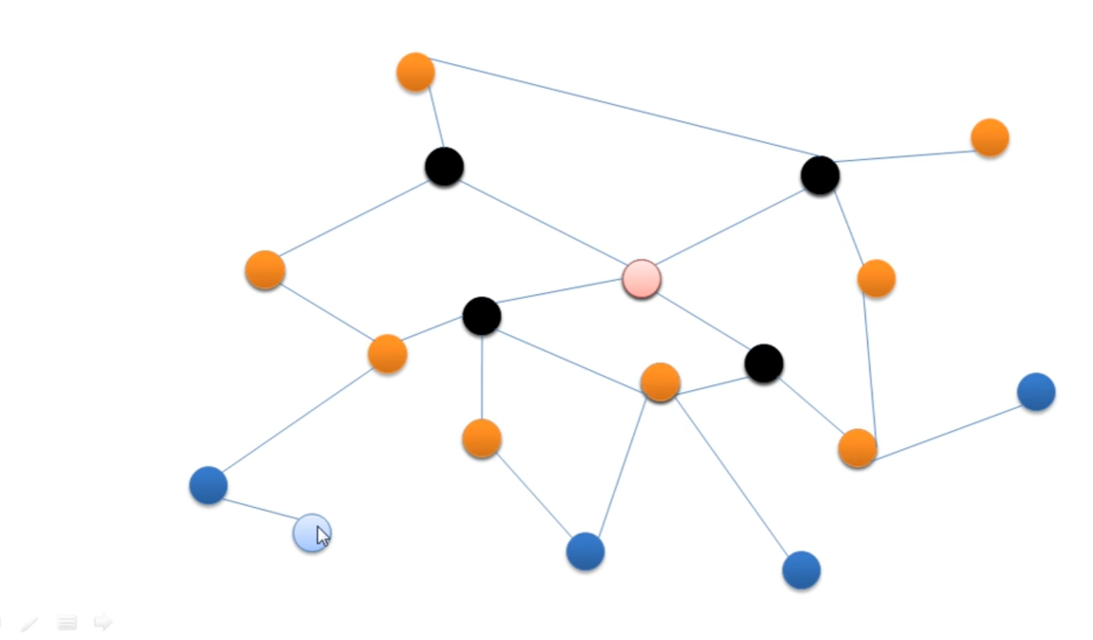
Design
Scope-1
Scope-2
Scope-3

Slide 14
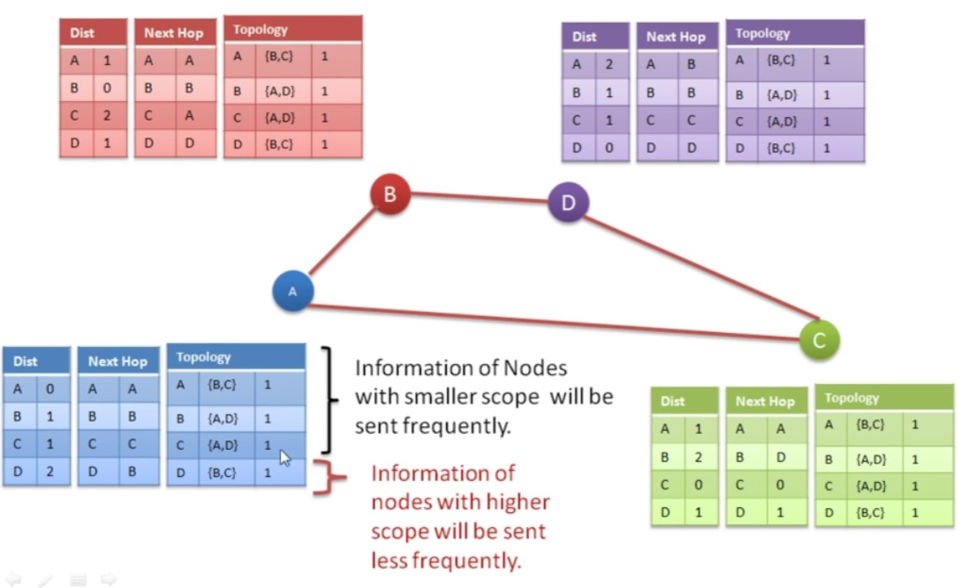

Slide 15
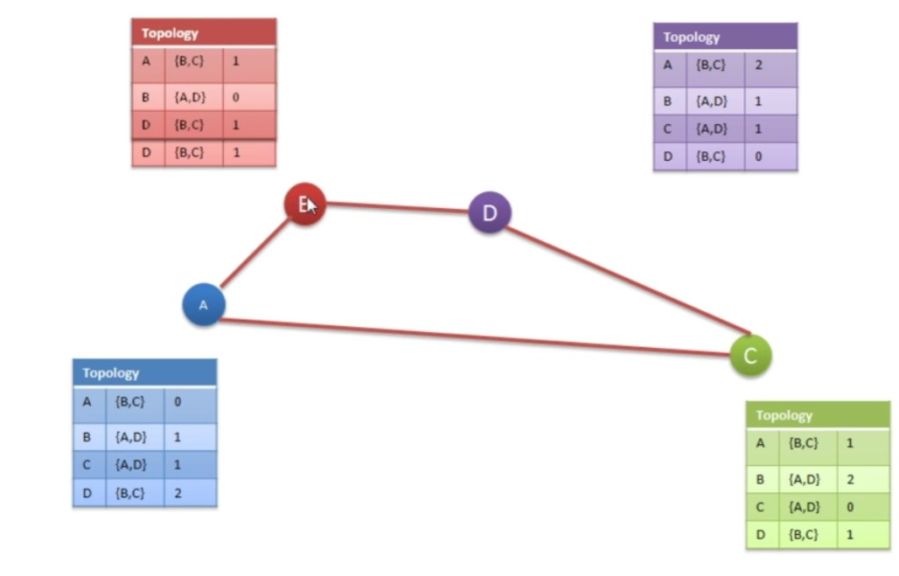

Slide 16
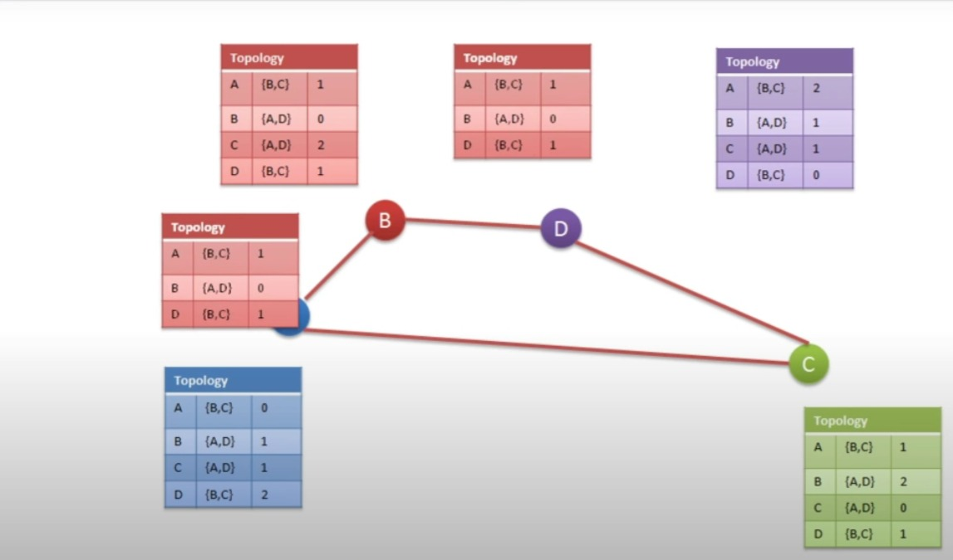

Slide 17
HOW DOES IT WORK?
However, accurate info is only maintain with close-by neighbors.
In any route, the next hop will always be a close-by neighbor.
The message will be 1-hop closer to the destination, and this node will have an accurate view of the network 1-step closer to the destination.
The process is repeated until the destination is reached.

Slide 18
PERFORMANCE OF FISHEYE
With each node focusing on maintaining accurate info with only a portion of the network, overhead is significantly reduced.
Periodic updates also further reduce network overhead but also at a cost.

Slide 19
CONCLUSION
The design of fisheye routing protocol makes it a good choice for ad-hoc networking.
Trade-off between protocol performance and network overhead.

